Slide 1
StO corp- lotus effect facade coatings Name : sakthi Darshini.v register no : 192512024
BTA0179 BIOLOGY AND ENVIRONMENTAL SCIENCE FOR ENGINEERS

Slide 2
INTRODUCTION
Nature has many self-cleaning surfaces — the best example is the lotus leaf.
The Lotus Effect refers to the leaf’s ability to repel water and dirt, staying clean even in muddy water.
Sto Corp developed Lotus-Effect coatings for building facades, inspired by this property.
These coatings make surfaces superhydrophobic and low maintenance.

Slide 3
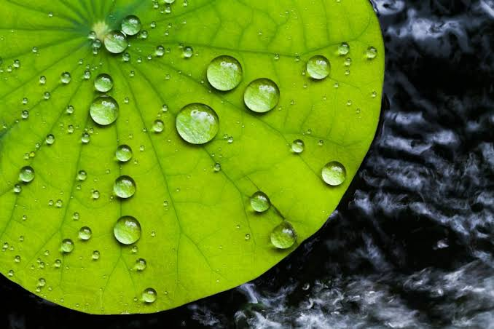
OBJECTIVE
To study and demonstrate the Lotus Effect.
To simulate a hydrophobic coating for building surfaces.
To compare plain vs. coated surfaces using contact angle measurement.
To understand how biomimicry and nanotechnology are used in real-life applications.

Slide 4
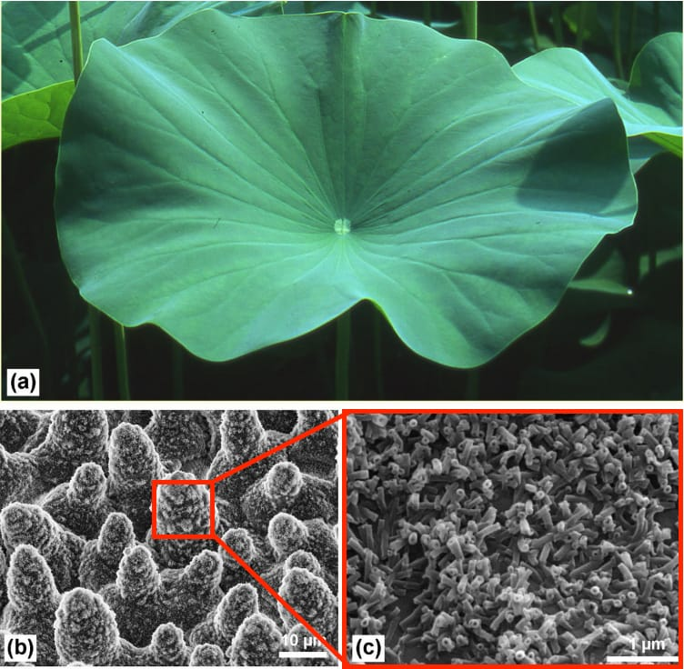
CONCEPT OF LOTUS EFFECT
The lotus leaf surface has microscopic bumps (micro/nano structures).
It is covered with a waxy layer that repels water.
When water falls, it forms round droplets that roll off easily.
As droplets roll, they pick up dirt particles, creating a self-cleaning effect.

Slide 5
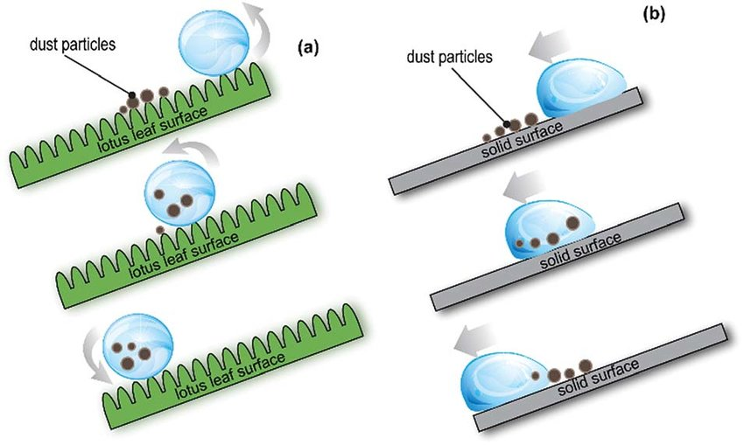
PRINCIPLE & MECHANISM
The property behind this is super hydrophobicity.
A surface is called superhydrophobic when the contact angle >150°.
Two key factors:
1. Surface roughness (micro/nano texture)
2. Low surface energy (due to wax or fluoropolymers)
Combined, they cause non-wettability and self-cleaning action.

Slide 6
MATERIALS AND METHODOLOGY
Materials Used:
Chart paper, glass tile/acrylic piece
Candle or wax
Water dropper
protractor (to measure contact angle)
Hydrophobic spray
Procedure:
1. Prepare two surfaces – one plain, one coated
2. Drop water on both.
3. Observe droplet behavior.
4. Measure contact angle and record observations.

Slide 7
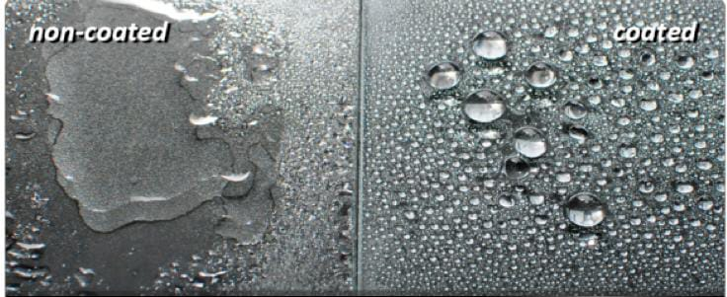
OBSERVATION AND RESULT
Surface type | observation | Contact angle | Result
Plain surface | Water spreads | 70 | hydrophillic
Coated surface | Water rolls off | 150 | superhydrophobic

Slide 8
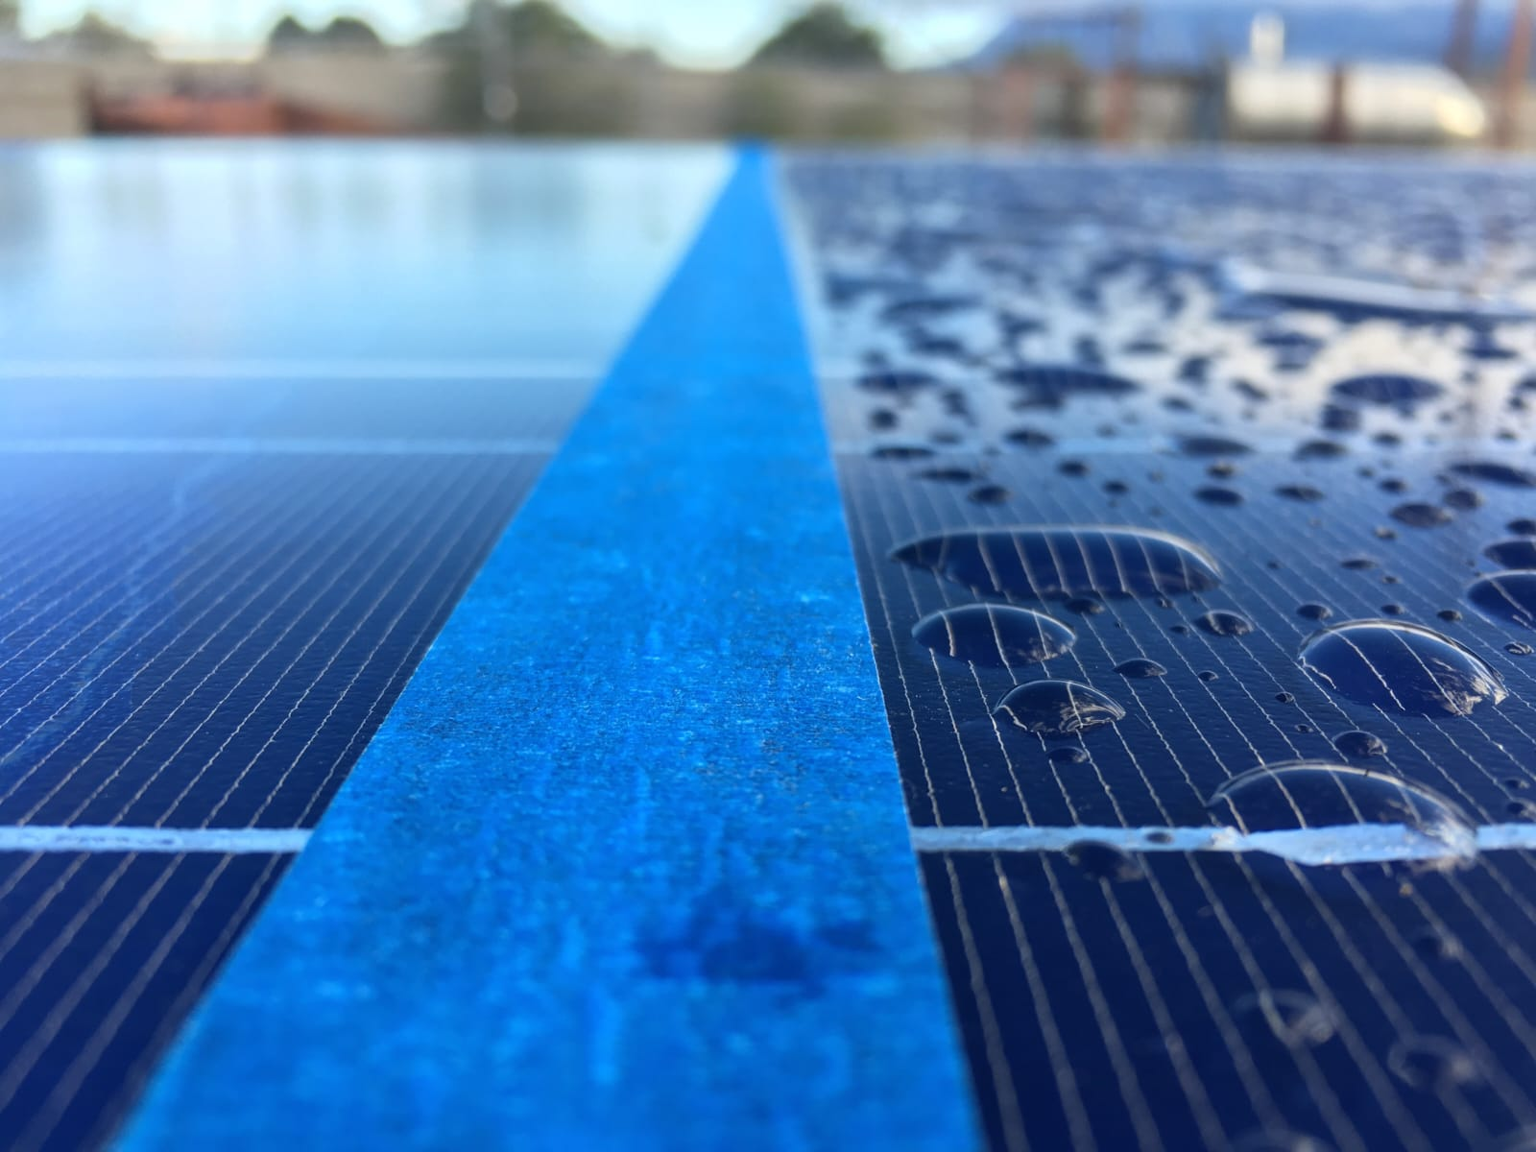
APPLICATIONS
Building and glass facades
Solar panels
Car windshields
Textiles and paints
Tiles and ceramics
Outdoor advertisements and signs

Slide 9
ADVANTAGES AND LIMITATION
Advantages:
Self-cleaning and low maintenance
Water and dust repellent
Long-lasting, UV resistant
Reduces cleaning cost
Limitations:
Expensive coating materials
Skilled application required
Effect reduces over time with wear

Slide 10
CONCLUSION
The Lotus Effect demonstrates how nature inspires modern technology.
Sto Corp’s coating replicates this effect to make facades self-cleaning and durable.
This project proved that superhydrophobic coatings can significantly reduce maintenance and improve building aesthetics.

Slide 11
ENGINEERING STANDARDS
ASTM D7334 – Contact Angle Measurement Used to measure the hydrophobicity of coated surfaces. It confirms the Lotus Effect by ensuring the contact angle is above 150° (superhydrophobic surface).
ISO 2409 – Cross-Cut Adhesion Test Ensures strong bonding of the coating to building surfaces like glass, tiles, or masonry.
ASTM D6578 – Cleanability of Coated Surfaces Tests how easily dirt or dust can be removed, proving the self-cleaning property.
ISO 9227 – Salt Spray Test Checks the coating’s durability and resistance to corrosion and weathering in outdoor environments.
ISO 14001 – Environmental Management Standard Ensures the coating process is eco-friendly, safe, and meets environmental protection requirements.

Slide 12
REFRENCES
1. Barthlott W., & Neinhuis C. (1997). Purity of the Sacred Lotus – Self-Cleaning Properties of Biological Surfaces. Planta, 202, 1–8.
2. Nosonovsky, M., & Bhushan, B. (2009). Superhydrophobic Surfaces and Emerging Applications. Springer.
3. Sto Corp. (2024). Lotusan Self-Cleaning Facade Coating Technical Data Sheet. Retrieved from www.stocorp.com
4. Zhang, X., Shi, F., & Noga, K. (2016). Design of Superhydrophobic Surfaces for Architectural Applications. Surface Engineering Journal, 32(4), 221–233.
5. ASTM D7334-08 (2013). Standard Practice for Contact Angle Measurement. ASTM International.

Slide 13


